Slide 1
Module 7 – Writing and presenting
Writing clinic
WORKSHOP PRESENTATION

Slide 2
Note for the facilitator
Module 7 ran as a clinic, with a communications specialist designing and delivering the session, rather than in a cascade like the rest of the programme. Because of this, there is no facilitation guide. However, the PowerPoint slides and handouts have been included and can be adapted for use. These materials were informed by a comprehensive review of all the teacher research reports and highlighted key issues and considerations that were common across the cohort of participating teachers.
Module 7 – Writing and presenting

Slide 3
Aims
To communicate and practise key writing and editing tools and techniques
To support teacher researchers to identify and resolve writing issues in their research texts
To encourage teacher researchers to spend time away from the workshop improving their research reports, using the tips provided.
Module 7 – Writing and presenting

Slide 4


Today is about tools not rules
Use what works for you!
Module 7 – Writing and presenting

Slide 5
Part of the process
Research
Editing
Publication
Write Up
Module 7 – Writing and presenting

Slide 6
Key takeaways
Your research is helping change your teaching practice and that of others, too.
The better it is written, the more it can effect change
We are not aiming for perfection – just a clear explanation of what you did and what you found.
All improvements to your text are welcome!
Module 7 – Writing and presenting

Slide 7
Session structure
What makes written text better or worse?
Planning. Making the most of your key points.
Paragraphs. Creating powerful paragraphs.
Data. Using data and charts in your research report.
Editing. Tips and techniques.
Module 7 – Writing and presenting

Slide 8
What makes written text better or worse?
While the relevant legislation and government targets are directed towards the equal treatment of pupils, regardless of their level of ability or particular need, and the local authority is positively promoting inclusion, there was unease noted in the review, illustrated largely in admission data, that some vulnerable children were disadvantaged, including being refused entry, by schools’ policies
Module 7 – Writing and presenting

Slide 9
What makes written text better or worse?
The review found that some children are disadvantaged by school admission and exclusion policies. Evidence for this finding is based on enrolment data, suggesting practice in some schools disregard legislation that ensures access to education for all children.
While the relevant legislation and government targets are directed towards the equal treatment of pupils, regardless of their level of ability or particular need, and the local authority is positively promoting inclusion, there was unease noted in the review, illustrated largely in admission data, that some vulnerable children were disadvantaged, including being refused entry, by schools’ policies
Module 7 – Writing and presenting

Slide 10
An example of good writing
The study was in three phases. First, I observed my pupils in two lessons and entered my findings in my journal. I also let three other colleagues observe lessons of group work in my class. I registered their feedbacks in my diary. My pupils were not active in group activities. I concluded that.
During the second phase, I tried to find out the reason for their low participation in group activity. I distributed open ended questionnaires to the children to state one thing each that they hate about group work. It was revealed that they were not prepared for the task, so they were not actively participating.
In the third phase, I looked for a teaching method that could increase their participation. Having responded to my open-ended questions and later closed questions, more than sixty percent of children agreed that giving them the topic of discussion ahead of the task can increase their participation in it. I proved that in two lessons and the children were so serious and active.
Module 7 – Writing and presenting

Slide 11
Some key tips to remember
Stop and think before you start writing. Make a note of the points you want to make in a logical order.
Prefer short words. Long words will not impress your customers or help your writing style.
Use everyday English whenever possible. Avoid jargon and legalistic words, and always explain any technical terms you have to use.
Keep your sentence length down to an average of 15 to 20 words. Try to stick to one main idea in a sentence.
Use active verbs as much as possible. Say ‘we will do it’ rather than ‘it will be done by us’.
Be concise. If it can be expressed with fewer words, do so.
Imagine you are talking to your reader. Write sincerely, personally, in a style that is suitable and with the right tone of voice.
Module 7 – Writing and presenting

Slide 12
Review your research
Read your research report, then write down three things you like and three things you don’t like about your written style.
After 15 minutes, share your ideas with a colleague and see if the discussion generates other ideas you can use to improve your report.
Make a note of these points to use when working on your report later.
Module 7 – Writing and presenting

Slide 13
Getting your planning right is the basis of good writing
When you lead with your key points, your research report is more confident and clear. Sections are stronger when the first sentence is the key point of that section.
This session of the workshop is not about rewriting your research report. It is a chance to check whether you are making the most of your key points.
Take a look at the first page of Presentation Handout 5 and think about the six key tips before reviewing your own work. What can you improve or add to strengthen your key points.
Module 7 – Writing and presenting

Slide 14
Example
Look at this strong example:
MY LEARNING FROM THE STUDY
Collaboration with colleagues can help to produce positive outcomes. I was helped by teachers to achieve the result of this research.
Because I was friendly with colleagues and also the pupils, this helped me and improved my efforts to get the best out of them.
Learning became interesting and effective for pupils to gain more.
Peer learning is more effective.
Module 7 – Writing and presenting

Slide 15
Making the most of your key points
Under each section heading, check whether your key points are prominent and clear.
Make a list of the key points you want to make under each heading. If they are already there, how can you make them clearer or more prominent? Does reordering help? Can you express them better?
Spend 30 minutes reviewing and improving your key points.
Module 7 – Writing and presenting

Slide 16
Creating powerful paragraphs
Paragraphs are the building blocks of your research report.
Each paragraph should contain one main point or idea.
A strong structure for a paragraph is: POINT. EVIDENCE. EXPLANATION. Use this structure for important paragraphs.
A topic sentence starts the paragraph and frames the entire idea or point.
A sentence contains one thought.
Varying sentence length injects pace and makes your writing more interesting to read.
Module 7 – Writing and presenting

Slide 17
Ensure each paragraph contains one idea
Example:
I discovered that pupils focused more on the individual work. They sometimes find questions difficult and ask their classmates for answers and sometimes turn to me for help, if they could not get the answers from their classmates. From this observation it was natural for my pupils to consult with each other. After all it was still difficult for me, so I decided to change their seating positions by bringing those at the front seat to the back.
Module 7 – Writing and presenting

Slide 18
Paragraphs
Look at this good example of a paragraph:
I learnt from my study that when kids are prepared for group work or discussion, they can do well in it. During my first observation my pupils were not active in the group exercises because they were not prepared. When I prepared them later on, they fully participated in the task that I gave them.
POINT. EVIDENCE. EXPLANATION. Can you identify these elements?
Module 7 – Writing and presenting

Slide 19
Paragraphs
Make important paragraphs follow a clear structure.
POINT. EVIDENCE. EXPLANATION.
Look at this example. Why does it read well and how is the main point made stronger?
Australia’s number one killer is heart disease, and it can easily be prevented by exercising. More than 1.6 billion people in the world are either overweight or obese and Australia has one of the highest rates of obesity. According to medical studies undertaken in the country, exercise reduces the risk of heart problems and several diseases which is why public health campaigns focus on exercising.
Module 7 – Writing and presenting

Slide 20
Paragraphs
A topic sentence is a strong opening sentence that makes your key point and summarises what the paragraph is about.
Examples:
I discovered that pupils focused more on the individual work.
It became clear that these pupils need some preparation before the actual group work.
In both cases, the rest of the paragraph should only expand on the information in the topic sentence. When reviewing your work, try to ensure your opening sentences (topic sentences) do the same job.
Module 7 – Writing and presenting

Slide 21
Paragraphs
Varying sentence length makes your report more interesting to read. It reads more confidently and clearly.
Example:
The study was in three phases. First, I observed my pupils in two lessons and entered my findings in my journal. I also let three other colleagues observe lessons of group work in my class. I registered their feedback in my diary. My pupils were not active in group activities. I concluded that.
Module 7 – Writing and presenting

Slide 22
Paragraphs exercise
Read through page of the Presentation Handout 5. Then take two of your most important paragraphs and revise them based on the key tips and techniques in this session.
Rewrite your paragraphs ensuring they have:
One main point or idea
A strong structure: POINT. EVIDENCE, EXPLANATION.
A topic sentence that summarises the whole paragraph
Sentences that contain one thought. If not, split them.
Sentences that are varied in length.
Module 7 – Writing and presenting

Slide 23
Good data is the foundation of credible research
Make sure it:
Supports your key points.
Is always explained and described
Shows comparison or difference where appropriate
Is clear and accurate.
Module 7 – Writing and presenting

Slide 24
Using data to make a key point
Look at this example:
When I observed that fifty-eight percent of my class was not serious about group work, I also let three other teachers observe three different lessons each observing the same areas that I did. The summary of their feedback was that more than fifty-three percent of the children were not active participants during the lessons.
What is the key point in this paragraph?
Evidence of lack of participation/interest. Key issue the research addresses.
Module 7 – Writing and presenting

Slide 25
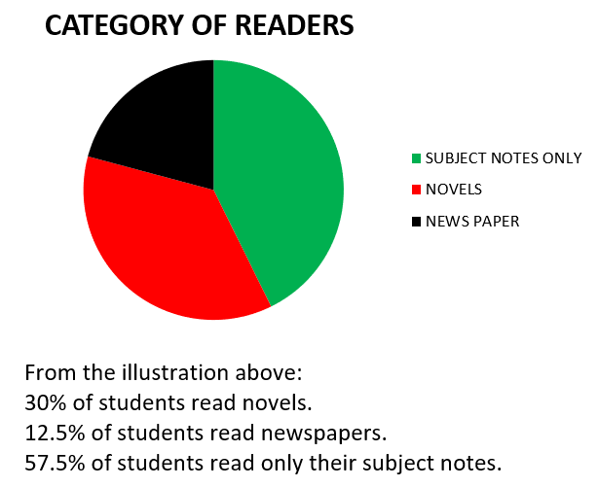
Clearly describe your data
Make sure the reader understands what they are looking at.
Look at this example.
Module 7 – Writing and presenting

Slide 26
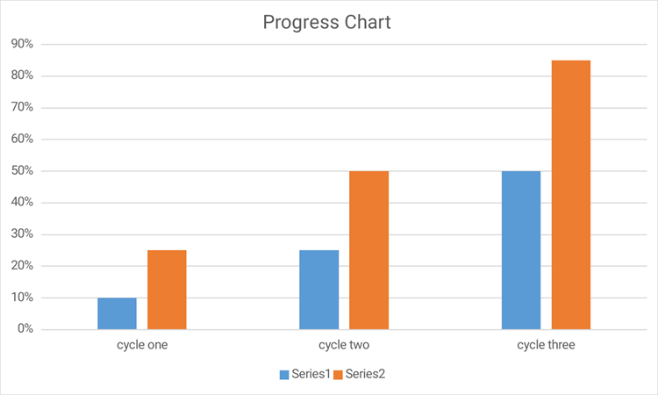
Bar charts are useful to show difference and change
Look at this mock up of comparisons between cycles in progress. The reader can easily see proportions and, in this case, before after.
Module 7 – Writing and presenting

Slide 27
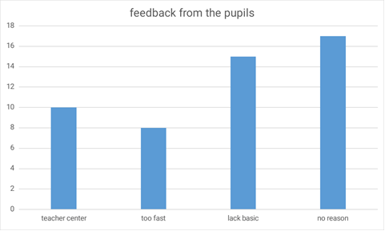
Strive for clarity and accuracy
Example: Feedback from pupils
Out of fifty (50) pupils in the class, 10 (20%) indicated that they could not participate in class because of teacher centered approach. 8 (16%) said that I teach too fast.
15 (30%) pupils indicated that, they lack the basic during their primary level and 17 (34%) has no reason.
Module 7 – Writing and presenting

Slide 28
Data
Take a look at Presentation Handout 3.
Then go through the data in your research report ensuring it meets the criteria and follows the tips provided.
The most important aspect of this exercise is to ensure the data clearly and accurately describes and supports a key point of your research.
Module 7 – Writing and presenting

Slide 29
Editing
So far in this workshop, you have been reviewing and improving your work. The changes you have made are important. Make sure these changes are included in the text that you now edit.
Now it is time to invest further in the editing process.
First, take time read through your research report. Make a note of what reads well and what you want to change. Underline text and/or make notes in the margin.
Module 7 – Writing and presenting

Slide 30
Looking at multiple data sources
You have two or three sources of data. When the data shows the following about your teaching, how do you combine them? How will you decide what action to take?
  22 out of 27 pupils said, I am very fast in my teaching and I am very harsh with them.
  The colleague said you are not paying attention to the weak learners. And you shout and rebuke them when they go wrong.
  You wondered if you were a bit impatient with your pupils.
  You therefore decide to adopt a friendly manner of teaching, giving the shy learners time and attention.
In the report you can say, ‘as the data clearly pointed to my way
of teaching, I tried to change the way I treated my pupils’.
Module 7 – Writing and presenting

Slide 31
Reaching conclusions based on evidence
These points are mentioned under conclusions:
  Teaching aids help and promote effective teaching.
  Slow learners should be involved in and given a pivotal position in group work.
Ask these questions about these conclusions:
  How has the researcher arrived at this conclusion? What data in the report supports this?
  Can the data/evidence be better explained?
  Which tools (e.g. questionnaire, interview, peer-observation) have been used to collect data to come to this conclusion?
Look for what the evidence points to in a direct way.
Module 7 – Writing and presenting

Slide 32
Getting your opening right
Check your work, asking these three essential questions and review and revise to make sure you can answer “yes” to all three:
Does the report’s introduction set the scene – describing the problem or challenge – and making it clear why the research project was necessary?
Does each section start with the main point I wish to make? We have already spent time on this – so you may want to review what you have already done.
Does the conclusion describe the main impact or result of the research?
Rewrite where necessary. Remember to lead with your main points. It is worth spending time on this exercise – as it can make a big improvement overall.
Module 7 – Writing and presenting

Slide 33
Activity: Getting Feedback
Now it is time to ask a colleague to read through your research report. Objective feedback can really help to improve written text.
Find someone who is not familiar with your work. Swap reports. Give her/him 20 minutes with your report, asking them to make constructive comments. Ask them to make notes on what they like, as well ad what is not clear. You do the same with hers/his.
Then spend 10 minutes each feeding back. Make sure you capture their comments before the next stage of the editing process.
Module 7 – Writing and presenting

Slide 34
Reduction and repetition
Now go through your research report again, looking for the following:
Ideas that are repeated. Aim to delete repetitions.
Long words or phrases that can be replaced with shorter ones. “At that time” can be replaced with “then”. “ I am of the opinion” can be replaced with “I think”.
Sentences that contain more than one thought, or ones that are very long (more than three lines)
Words such as “very”, “incredibly”, “happily” are usually not necessary.
The more concise your research report, the clearer it will be.
Module 7 – Writing and presenting

Slide 35
Check your spelling
Finally, the spell checker is always worth using. But, be careful! You must check each suggestion it makes.
In most versions of Word, there is a Review button in the main Toolbar. If you click this, and then click on Spelling, all of the Editor’s suggestions will come up.
Review each before accepting – especially as names will usually be flagged for editing.
Module 7 – Writing and presenting

Slide 36
After this writing clinic…
Finally, please take more time outside this clinic to review your work and go through the handouts.
Every improvement you make – however small – will ensure that the final publication is the highest possible quality.
Module 7 – Writing and presenting

Slide 37
Reviewing and revising titles
This activity should be done once a little has time passed since you last looked at your report
Ask this question about the title: “Does the title capture the thrust of the study fully?”
If the answer is ‘not quite’, it’s time to change the title so that it reflects what the study is discussing.
Think of a title that captures the main focus. If the major focus is on enabling girls to participate in the lesson, mention that in the title. If the major focus is on enabling participation through pair and group work, then that should be reflected in the title.

Slide 38
Wording of the title
The title can be a question or a phrase.
See this example: “‘Some students in JSS II like group work while some do not”
Other possibilities:
“Why don’t all my students like to work in groups?”
    “Why do only some students like to work in groups but not others?”
    “How can I get everyone to like group work?”
    “Making group-work work for everyone”.
Make it catchy and short. It should get the reader interested to read the report.
Module 7 – Writing and presenting

Slide 39
Activity: Wording of the title
  Small groups of mentors and the teacher who are now familiar with the work come up with 3-4 possible titles.
  Put them all down.
  Have a discussion around which title(s) best represent the study and most catchy.
  Give us 2-3 alternatives when you hand in your final report. We can decide on one by looking at other titles and ensure that there are no repetitions in the book.
Module 7 – Writing and presenting

Slide 40
Plagiarism
Copying someone else's work, ideas or sentences as your own, without acknowledging it. This is not allowed when we’re authors in a published book.
When you are reviewing your reports, pay special attention to the sentences which you may have borrowed from a source without your knowledge. For example, the Bangladesh ‘Teachers’ Voices book’ or the Sierra Leone ‘Teachers as Change Agents’ book
Reword these sentences if you still want to keep the ideas. Or delete them and add your own.
Module 7 – Writing and presenting

