Slide 1
Module 3 – Understanding the initial stages of teacher research
Mentoring Teacher Researchers*
*A version of this presentation was first given by Jemima Hughes, British Council, Delhi and Rama Mathew, ELT Consultant at the AARMS Seminar, British Council, in September 2018.
WORKSHOP PRESENTATION

Slide 2
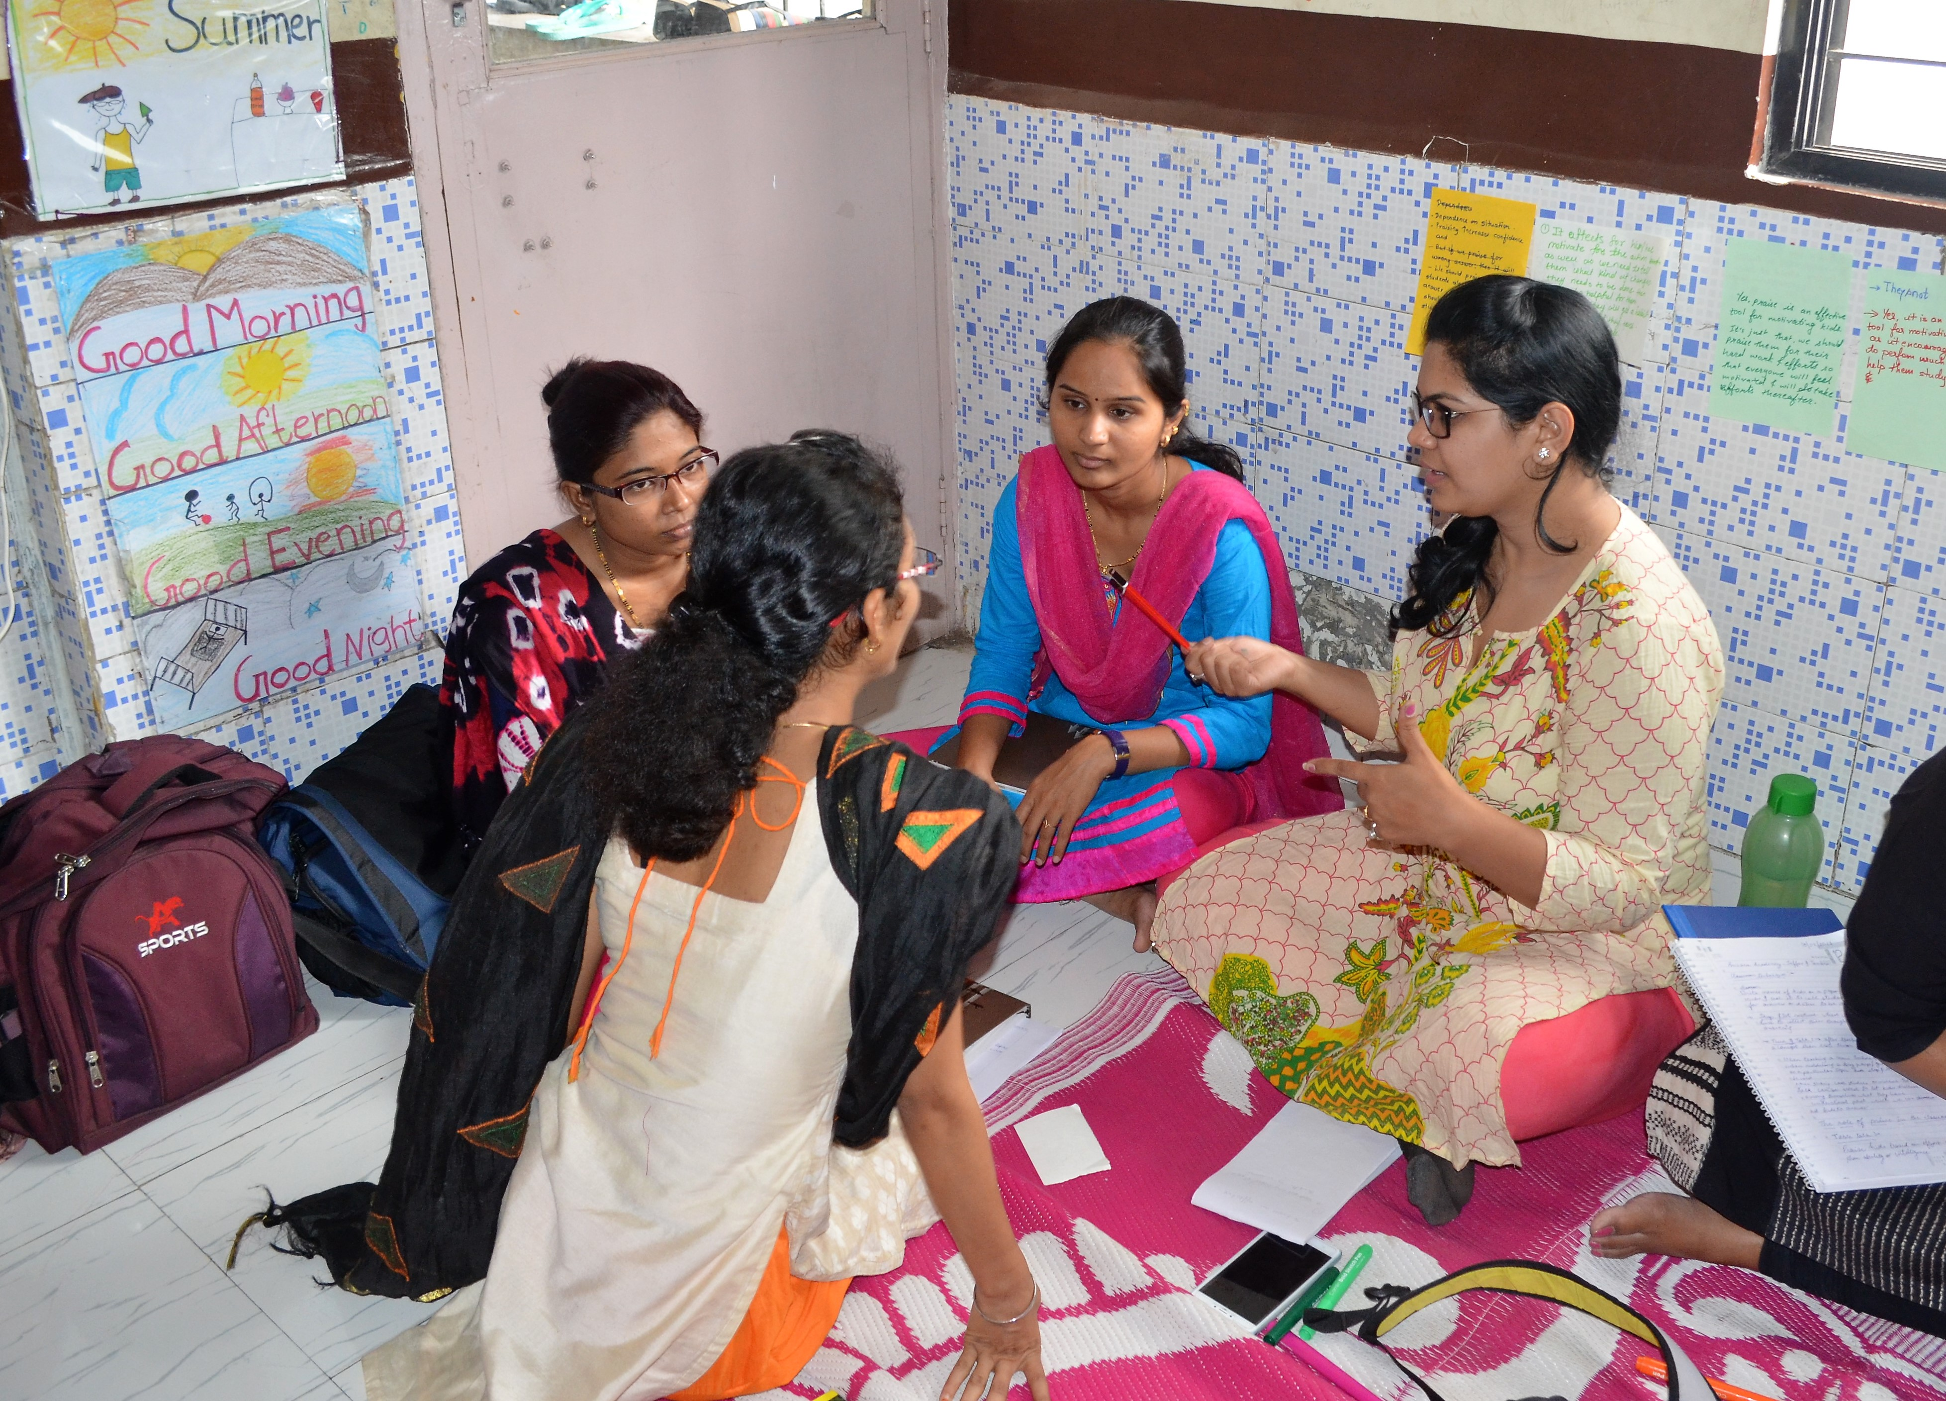
Mentoring teacher researchers
Module 3 – Mentoring teacher researchers

Slide 3
Clarification of basic terms
A ‘mentor’ supports others, usually someone who is in the process of developing/growing.
The person, who is mentored is normally called a ‘mentee’.
This doesn’t mean that only the mentee is mentored. In a collegial relationship both mentor each other and learn from each other.
For our purpose here we will refer to the mentee as teacher researcher as we are focusing on mentoring teacher research.
Module 3 – Mentoring teacher researchers

Slide 4
Debunking myths
A mentor can be any age
Everyone – regardless of age – can benefit from mentoring
Mentoring is not about telling people what to do
Mentoring can be helpful for people in any situation – regardless of their success or experience
You can learn to be a mentor - which is what we’re going to do!
Module 3 – Mentoring teacher researchers

Slide 5
Qualities of a good mentor
non-judgmental
listens and actively questions
supportive
a critical friend
scaffolds TR’s work
respectful
systematic
reflective
professional
motivator
helps the TR ask the right questions
approachable
Module 3 – Mentoring teacher researchers

Slide 6
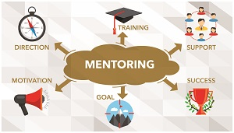
Can we learn to be good mentors?
Formally by ‘doing’ courses, workshops etc.
Informally by ‘being’ mentors, observing other mentors
A combination of the two, e.g. Leh Wi Lan project
Module 3 – Mentoring teacher researchers

Slide 7
Mentoring teacher researchers
An open, wide-ranging process to improve the teacher researcher’s teaching practice that contributes to their ongoing professional development
A formalised process which usually includes evaluation of TR’s competence and performance
The mentor is normally more experienced than the TR
A non-hierarchical professional relationship in which both participants learn.
Module 3 – Mentoring teacher researchers

Slide 8
Mentoring teacher researchers
Two types:
Mentoring/supervising research work of MPhil/PhD scholars (academic mentoring
Mentoring teachers/colleagues in their classroom research (not leading to a degree)
Module 3 – Mentoring teacher researchers

Slide 9
The model
Mentor-model of teacher research is a lot like collaborative research. Teachers get continuous support from mentors working and learning together.
Mentors take many more responsibilities, are willing to give time, and to work within a CoP (Community of Practice*)
*All of us, teachers, teacher educators and learners are part of a professional community asking and answering classroom related questions.
Module 3 – Mentoring teacher researchers

Slide 10
Mentoring teacher researchers
‘..a two way synergistic learning process, rather than a kind of one-way apprenticeship’ (Mullen and Lick 1999).
‘…self-study through co-enquiry. Both mentor and TR are seeking to improve their work-based practice’ (Fletcher 2003).
What separates teacher research from everyday teaching and learning is that work is shared, systematised and validated.Mentors and TRs help each other to achieve this process.
Mentor acts like a ‘sounding board’ listening, questioning, probing, supporting teacher researchers in their group.
There is an active professional group/community that is created who all share a common language and concern.
Module 3 – Mentoring teacher researchers

Slide 11
Benefits
Greater focus on collective and collaborative understanding and learning.
Both learn to do better classroom research, learn to do better mentoring, resulting in enormous benefits.
Allows networking, sharing within and across groups, writing up research studies, collating all the learning/gathering all insights together into a coherent whole.
Many more teachers can become part of the network with the support of ‘new’ mentors, they become mentors next...
Module 3 – Mentoring teacher researchers

Slide 12
What does this mean?
All of us, teachers, teacher educators and learners are part of a professional community asking and answering classroom related questions.
This leads to teachers mediating theory and developing one’s own personal theory that is meaningful, validated and evidence-based
This is an ongoing process (unlike academic research)
Module 3 – Mentoring teacher researchers

Slide 13
Key responsibilities
A mentor aims to empower teachers to identify their own issues and pathway – not by telling them what to do but by questioning, listening, paraphrasing and suggesting different choices.
A mentor is able to elicit the problems and opinions of others, and of providing them with non-judgmental, non-directive guidance –you may already have some of the qualities and skills of a good mentor.
If not, you may find that developing as a mentor will transfer positively to your work with pupils and more broadly to your life - at least, this is what some teachers who have become teacher research mentors have said.
Module 3 – Mentoring teacher researchers

