Slide 1
Module 1 - Understanding and doing classroom-based research
What kind of teacher research are we focusing on?
WORKSHOP PRESENTATION

Slide 2
Terms and types of teacher research
Teacher research/Practitioner research
Action research
Classroom based research
Exploratory action research
Sometimes these terms are interchangeably used. The defining feature is that it is research by teachers and for teachers
Module 1 - Understanding and doing classroom-based research

Slide 3


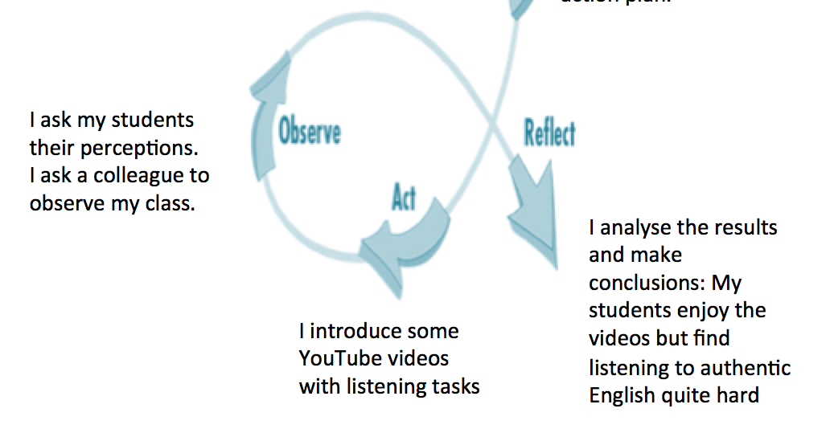
Action Research (AR)
Module 1 - Understanding and doing classroom-based research

Slide 4

Exploratory Action Research (EAR)
From Smith (2020)
Module 1 - Understanding and doing classroom-based research

Slide 5
Comparison of AR and EAR
Module 1 - Understanding and doing classroom-based research

Slide 6
EAR and AR as a continuous process
Action research
Exploratory action research
(from Smith & Rebolledo, 2018)
The ‘action’ is optional, and always preceded by exploration.
Module 1 - Understanding and doing classroom-based research

